Slide 1
Session 7
Cloud Service Models

Slide 2
Objectives
Definition and characteristic of
IAAS
PAAS
SAAS

Slide 3
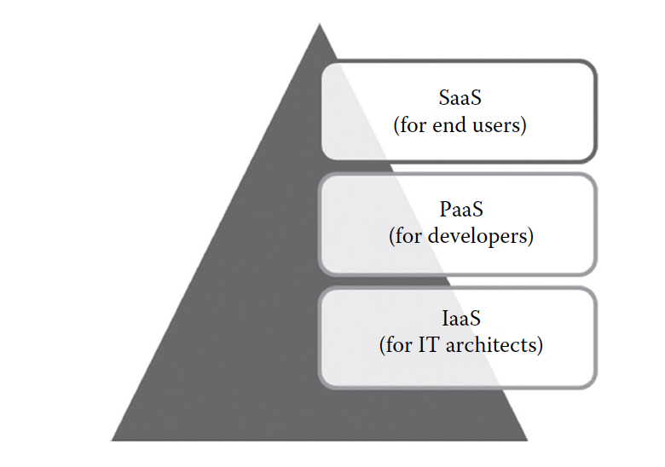
Introduction
The National Institute of Standards and Technology (NIST) defines three basic service models, namely, IaaS, PaaS, and SaaS

Slide 4
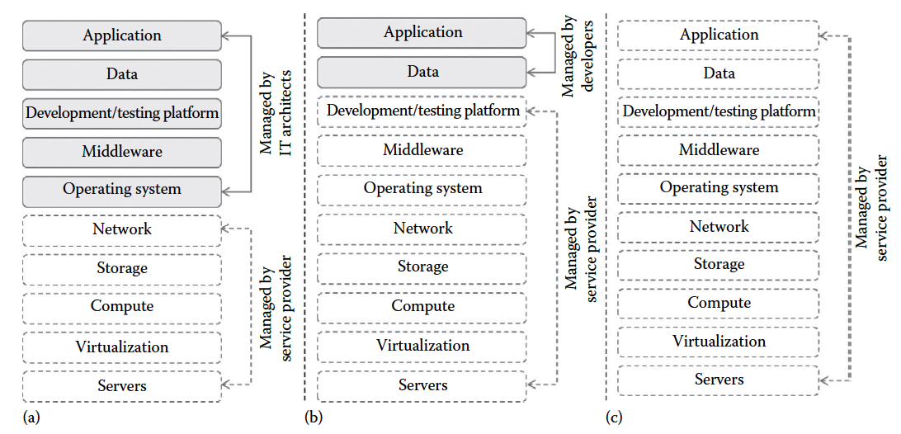
User and service provider responsibilities of cloud service models
Which one is IaaS, PaaS, or SaaS?

Slide 5
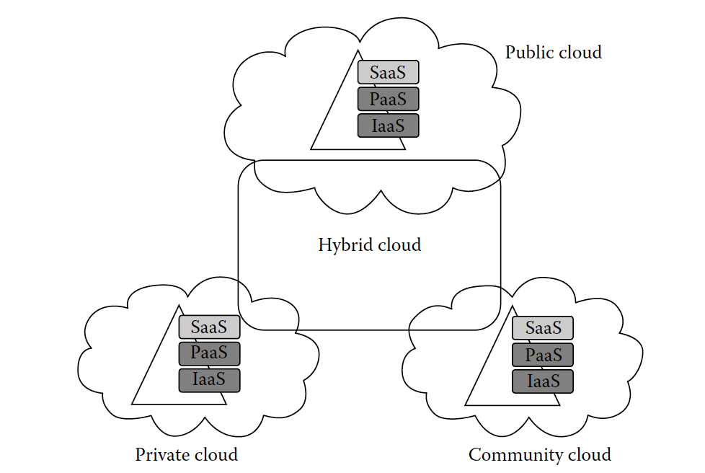
Deployment and delivery of different cloud service delivery models

Slide 6
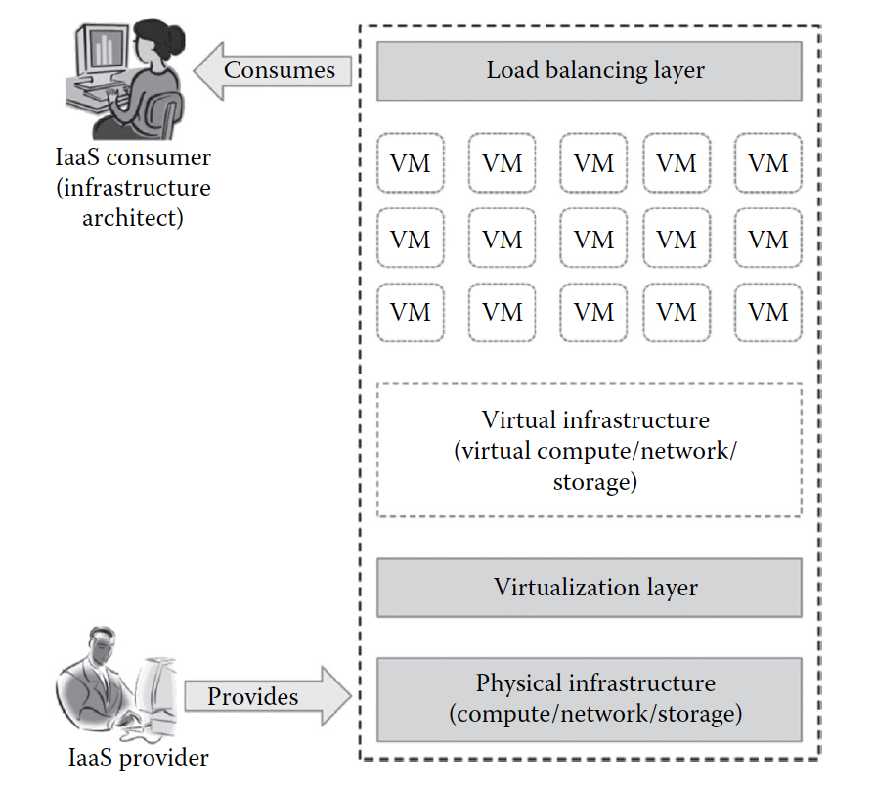
Infrastructure as a Service
IaaS changes the computing from a physical infrastructure to a virtual infrastructure
IaaS provides virtual computing, storage, and network resources by abstracting the physical resources
All the virtual resources are given to the virtual machines (VMs) that are configured by the service provider

Slide 7
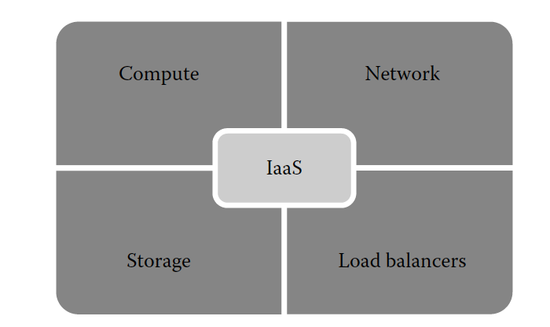
Services provided by IaaS providers
central processing units (CPUs) and virtual main memory for the VMs that are provisioned to the end users
provides virtual networking components such as virtual router, switch, and bridge for the VMs
Some of the IaaS providers also provide the back end for storing files.
provides load balancing capability at the infrastructure layer

Slide 8
Characteristics of IaaS
Web access to the resources:Through any web browsers or management console, the users can access the required infrastructure
Centralized management: Even though the physical resources are distributed, the management will be from a single place.
Elasticity and dynamic scaling: The usage of resources can be increased or decreased according to the requirements
Shared infrastructure: Allows multiple IT users to share the same physical infrastructure. IaaS ensures high resource utilization.

Slide 9
Characteristics of IaaS
Preconfigured VMs: The IT users can select any kind of VMs of their choice. The users can directly start using the VMs as soon as they subscribed to the services
Metered services: The services consumed by the IT user will be measured, and the users will be charged by the IaaS providers based on the amount of usage.

Slide 10
Suitability of IaaS
IaaS reduces the total cost of ownership (TCO) and increases the return on investment (ROI) for start-up companies that cannot invest more in buying infrastructure.
IaaS can be used in the following situations
Unpredictable spikes in usage
Limited capital investment
Infrastructure on demand

Slide 11
Drawbacks of IaaS
Security issues: Since IaaS uses virtualization as the enabling technology, hypervisors play an important role. There are many attacks that target the hypervisors to compromise it
Interoperability issues: It is very difficult to migrate any VM from one IaaS provider to the other. Sometimes, the customers might face the vendor lock-in problem
Performance issues: Latency of the network plays an important role in deciding the performance. Because of latency issues, sometimes the VM contains issues with its performance

Slide 12
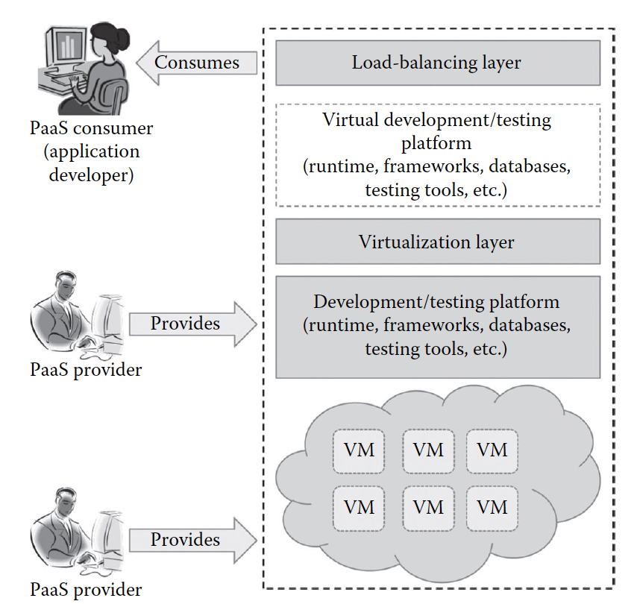
Platform as a Service
PaaS allows the developers to develop their application online and also allows them to deploy immediately on the same platform
It reduces the complexity of buying and maintaining different tools for developing an application
Typical PaaS providers may provide programming languages, application frameworks, databases, and testing tools

Slide 13
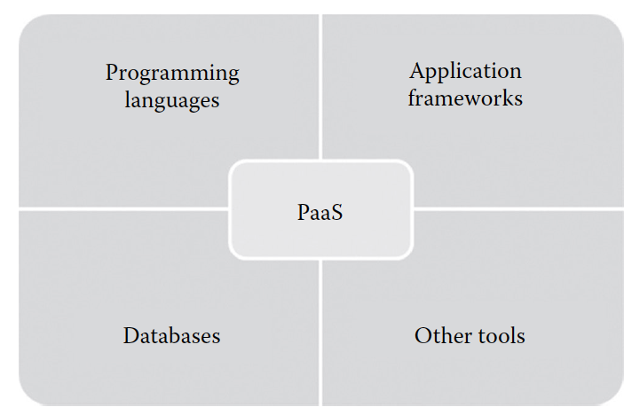
Services provided by PaaS provider
PaaS providers provide a wide variety of programming languages for the developers
Some of the popular application development frameworks provided by a PaaS provider include Node.js, Rails, Drupal, Joomla, WordPress
The popular databases provided by the popular PaaS vendors are ClearDB, PostgreSQL, Cloudant,, MongoDB
PaaS providers provide all the tools that are required to develop, test, and deploy an application

Slide 14
Characteristics of PaaS
All in one: Most of the PaaS providers offer services to develop, test, deploy, host, and maintain applications in the same IDE
Using web UI, any developer can get access to the development platform. The web-based UI helps the developers create, modify, test, and deploy different applications on the same platform.
Offline access: Some of the PaaS providers allow the developer to synchronize their local IDE with the PaaS services
Built-in scalability: This ensures that the application is capable of handling varying loads efficiently

Slide 15
Characteristics of PaaS
Collaborative platform: Developers can collaboratively work together on the same project from different workplaces.
Diverse client tools: To make the development easier, PaaS providers provide a wide variety of client tools to help the developer

Slide 16
Suitability of PaaS
Collaborative development: A common place where the development team and other stakeholders of the application can collaborate with each other
Automated testing and deployment: The development team needs to concentrate more on development rather than testing and deployment.
Time to market: The PaaS services follow the iterative and incremental development methodologies. The PaaS services are the best option for application development that uses agile development methodologies

Slide 17
Drawbacks of PAAS
Vendor lock-in: Because proprietary technologies used by PaaS providers so that the applications to be migrated from one PaaS provider to the other.
Security issues: Since data are stored in off-premise third-party servers, developers are afraid to go for PaaS
Less flexibility: PaaS providers do not give much freedom for the developers to define their own application stack
Depends on Internet connection: With slow Internet connection, the usability and efficiency of the PaaS platform do not satisfy the developer requirements

Slide 18
Software as a Service
There is no need to install the software to the end user’s devices.
SaaS services can be accessed or disconnected at any time based on the end user’s needs
SaaS services can be accessed from any lightweight web browsers on any devices such as laptops, tablets, and smartphones.
The important benefits of using thin clients for accessing the SaaS application are as follows: it is less vulnerable to attack, has a longer life cycle, consumes less power, and is less expensive

Slide 19
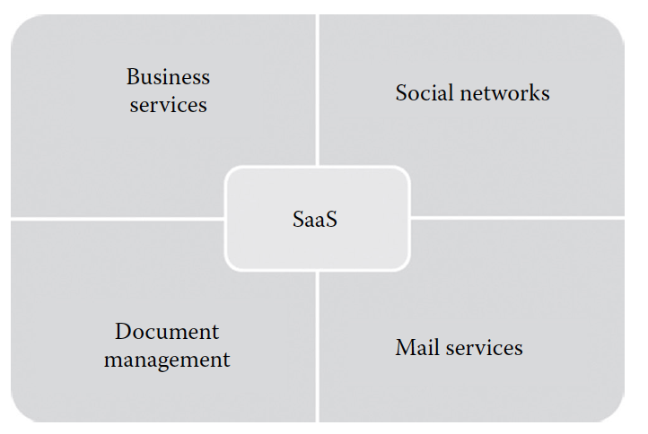
provided by SaaS Providers.
The business SaaS services include ERP, CRM, billing, sales, and human resources
Since the number of users of the social networking sites is increasing exponentially, cloud computing is the perfect match for handling the variable load
services that are used to create, manage, and track electronic documents
most of the e-mail providers started offering their services as SaaS services

Slide 20
Characteristics of SaaS
One to many: application can be shared by multiple tenants or customers
Web access: It allows the end user to access the application from any location with internet connection
Centralized management: the SaaS providers will perform the automatic updates that ensure that each tenant is accessing the most recent version of the application without any user-side updates
Multidevice support: can be accessed from any end user devices such as desktops, laptops, tablets, smartphones

Slide 21
Characteristics of SaaS
Better scalability: The dynamic scaling of underlying cloud resources makes SaaS applications work efficiently even with varying loads.
High availability: ensure the 99.99% availability of user data as proper backup and recovery mechanisms are implemented at the back end
API integration: the capability of integrating with other software or service through standard APIs

Slide 22
Suitability of SaaS
On-demand software: The licensing-based software model increases the spending on buying software.
Software for start-up companies: Can reduce the initial expenditure on buying high-end hardware
Software compatible with multiple devices: The SaaS applications are adaptable with almost all the devices.
Software with varying loads: Applications can handle varying loads efficiently without disrupting the normal behavior of the a

Slide 23
Drawbacks of SAAS
Real-time applications: Since SaaS applications depend on Internet connectivity, it may not work better with low Internet speed
Applications with confidential data: Since data are stored with third-party service providers, there is no surety that our data will be safe.
Better on-premise application: In such situations, migrating to the SaaS model may not be the best option.

Slide 24
Pros of SaaS
No client-side installation
Cost savings
Less maintenance
Ease of access
Dynamic scaling
Disaster recovery
Multitenancy:

Slide 25
Cons of SaaS
Security: Security is the major concern in migrating to SaaS application. Since the SaaS application is shared between many end users, there is a possibility of data leakage
Connectivity requirements: Sometimes, the end user’s Internet connectivity might be very slow.
Loss of control: Since the data are stored in a third-party and off-premise location, the end user does not have any control over the data.

Slide 26
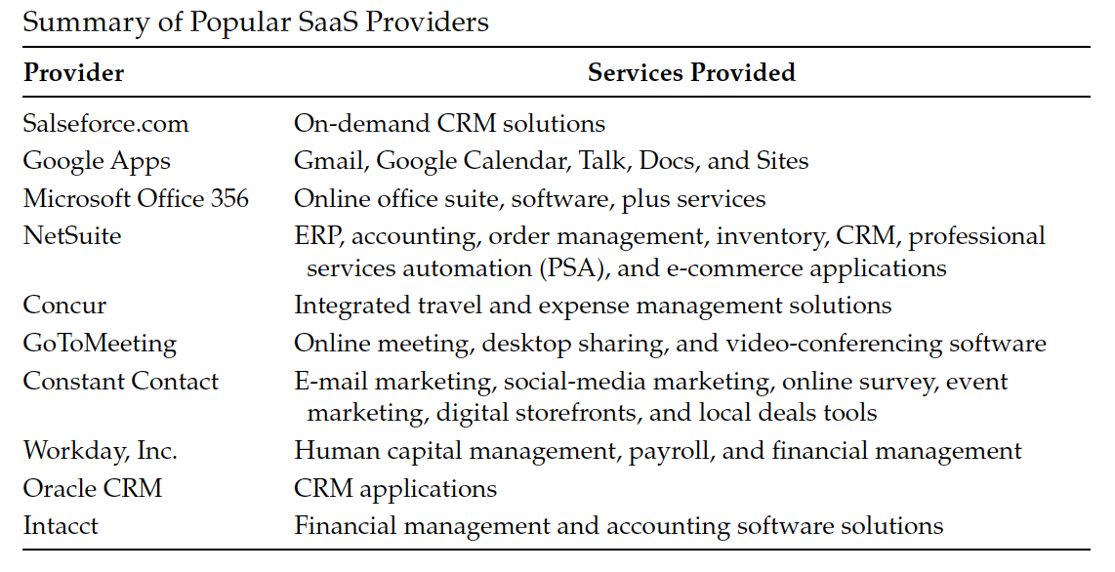

Slide 27
Summary
IAAS
PAAS
SAAS

Slide 28
References
https://www.ibm.com/cloud/learn/iaas-paas-saas

